Slide 1



Software engineering (Undergraduate)
Chapter 1 fundamental concepts of project management
Course Name software Development project management
CSC 4125
(Undergraduate)
M. Mahmudul hasan
Assistant Professor, CS, AIUB
http://www.dit.hua.gr/~m.hasan

Slide 2
What is a project?
MMH
A temporary (finite) group of related tasks undertaken to create a unique product, service, or result.
Key characteristics of a Project:
Non-routine tasks involved
Planning is required
Specific objectives are to be met or Specified product is to created
The product development has a predetermined time span (deadline)
Work is carried out for someone other than yourself
Work involves several specialism (area)
Work is carried out in several phases
The resources (time, budget) that are available for use on the project are constrained (controlled)
The project is large or complex

Slide 3
Operational Work vs. Project
MMH
Operational Work
On going / Day to day work
Has no beginning or end
Keeps the business running
Maintains the product
Maintains the core work for projects
Represents all the work the business does
Project
Temporary
Has an expiration date
Helps to expand the business
Builds new products
Changes the way of business

Slide 4
Software project
MMH
The process of making visible that which is invisible
Comparisons with other types of project:
Invisibility: When a bridge is being constructed the progress being made can actually be seen
Complexity: Software products contain more complexity (e.g. logical) than other engineered artifacts
Conformity: Traditional’ engineers usually work with physical systems and materials (e.g. cement, steel) that have complexity, but these are governed by consistent physical laws. Software developers have to conform to the requirements of human clients.
Flexibility: The software systems are likely to be subject to a higher degree of change

Slide 5
Project management
MMH
Project Management uses skills, knowledge, and resources to satisfy project requirements
The Project Manager is:
In control of the project
Formally empowered to use organizational resources
Authorized to spend the project’s budget
Authorized to make decisions for the project

Slide 6
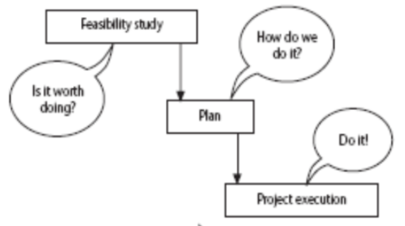
Software Project management activities
MMH
The Feasibility Study
Investigation to decide whether a prospective project is worth starting
Planning
Guidance to execute, monitor, and control a project
Project Execution
The implementation of a projects

Slide 7
Process & Phases
MMH
Software Process:
Defines all the tasks required for developing and maintaining software
Software Process Phases:
The activities of a software process are termed as phases

Slide 8
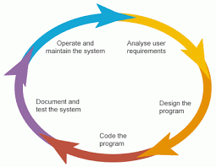
Typical software project lifecycle
MMH
Requirement Analysis
Specification/Design/Modelling
Development/Coding
Testing
Implementation/Installation/Deployment
Maintenance and support
Documentation

Slide 9


Software project categories
MMH
Information systems vs. embedded systems
Information system interfaces with the organizations, enable staff to carry out office process (e.g. a stock market system)
Embedded system interfaces with a machine to control machines (e.g. autopilot to control an airplane, air conditioning equipment in a building) real-time system

Slide 10

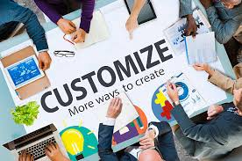
Software project categories
MMH
Objectives vs. Products driven system
Product driven software (OTH software): Projects may be distinguished by whether their aim is to produce a product (commercial off-the self product)
Objective driven software (Customize software): Meet certain objectives (improve service level, client specify requirements details)

Slide 11
Type of systems
MMH
Systems, subsystems and environments (e.g. cashier’s workstation in a supermarket)
System: a set of interrelated parts (barcode scanner, keyboard, monitor, cash drawer)
Subsystem: part of a larger system
Environment:
Outside the system (actor)
Things that affect the system
System has no direct control (to the environment)
Open systems
Open systems interact with the environment
Nearly all systems are open

Slide 12
Type of systems
MMH
Sub-optimization
Where a subsystem works at optimum but have detrimental (damaging) effect on the overall system
Example: a system that uses machine resources efficiently but is very difficult to modify
win-win decision making
Socio-technical systems
Project Manager (PM) needs to have both technical competence as well as the ability to interact persuasively with other people

Slide 13
What is management?
MMH
Involves the following activities:
Planning: deciding what is to be done
Organizing: making arrangements
Staffing: selecting right people for the job
Directing: giving instructions
Monitoring: checking on progress
Controlling: taking action to remedy hold-ups (a situation causes delay)
Innovating: coming up with new solutions
Representing: liaising (cooperate on matter of mutual concern) with users etc.

Slide 14
problems with software projects (Common)
MMH
Poor estimates and plans
Lack of quality standards and measures
Lack of guidance about making organizational decisions (e.g. priority)
Lack of techniques to make progress visible
Poor role definition – who does what
Incorrect success criteria (feasibility)

Slide 15
problems with software projects (others)
MMH
Inadequate specification of work
Management ignorance of IT
Lack of knowledge of application area
Lack of up-to-date documentation
Schedule slips, Deadline pressure
Lack of communication
Lack of commitment
Narrow scope of technical expertise
Changing regulatory, established, mandatory requirements
Changing software environment
Lack of quality control
Remote management
Lack of training

Slide 16
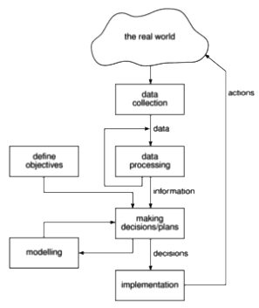
Management control
MMH
THE PROJECT CONTROL CYCLE:
MANAGEMENT is the process of setting objectives for a system and then monitoring the system to see what its true performance is

Slide 17
Management control
MMH
OBJECTIVES:
Project objectives should be clearly defined
For successful software project:
The manager must know what will constitute success
For more than one user group:
Project Authority needs to be identified
Project steering committee has overall responsibility for:
Setting, monitoring, and modifying objectives
Authorizing changes to the project objectives and resources
The committee is likely to contain user development and management representatives.

Slide 18
Management control
MMH
MEASURES OF EFFECTIVENESS:
Effective objectives are concrete and well defined
Measure of effectiveness tell us how successful the project has been
The measure can, in some cases, be an answer to simple yes/no question
Example: ‘to reduce customer complaints by 50%’ would be more satisfactory to improve customer relations’.

Slide 19
Management control
MMH
SUB-OBJECTIVES AND GOALS:
Objectives broken down into sub-objectives keep things manageable
Sub-objectives are also known as goals
GOALS: steps on the way to achieving an objective.
Requirements related to “Reliability” can use different measures to quantify the goal
Property | Measure
Reliability | Mean (indicate) time to failure Rate of failure occurrence Probability of failure

Slide 20
stakeholders
MMH
Stakeholders are people who have a stake or interest (involvement) in the project.
Different types of stakeholders might have different objectives and successful PM recognizes these different interests and reconciles (find a solution) them
It is important that they be identified as early as possible, because PMs need to set up adequate communication channels with them right from the start.
The PM needs to be a good communicator and negotiator
PM should find all of the stakeholders & keep them updated about the progress of the project. Makes sure that the stakeholder’s expectations are met

Slide 21
stakeholders
MMH
Stakeholders might be:
Internal to the project team
under the direct managerial control of the project leader (e.g. development team)
External to the project team but in the same organization
Example:
assistance of the information management group
Totally external to the organization
Example:
customers who will benefit from the system that the project implements
contractors who will carry out work for the project

Slide 22
stakeholders
MMH
Negative Stakeholder
Who thinks the project might bring negative consequences
How to work with them?
Manage their expectations
Motivate all stakeholders
Stakeholder Identification
Figure out all the stakeholders
Stakeholder Register
Goals (business requirement)
Expectations (user requirement)

Slide 23
Requirement specification
MMH
Functional Requirements
define what the system that will be the end product of the project is to do
Quality Requirements
define how the system that will be the end product of the project is to do
Resource Requirements
define a record of how much the organization is willing to spend on the system
Tradeoff
Everybody likes exceptionally reliable and user-friendly systems with the exact required functionality but might be expensive

Slide 24
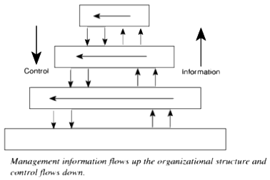
Information and control in organization
MMH

Slide 25
Information and control in organization
MMH
Levels of DECISION MAKING & INFORMATION:
Strategic Decision Making
essentially about deciding objectives
Tactical Decision Making
ensures that the objectives are fulfilled
Operational Decision Making
relates to the day-to-day work of implementing the project

Slide 26
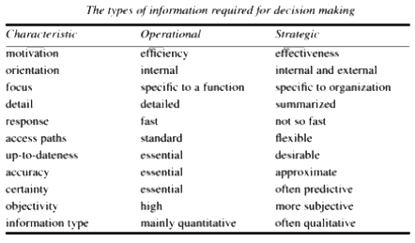
Information and control in organization
MMH
Differences in Types Of Information:
Effectiveness is concerned with doing the right thing.
Efficiency is carrying out a task making the best possible use of the resources

Slide 27
references
MMH
Bob Hughes and Mike Cotterel (1999). Software Project Management (Second Edition).

